Slide 1
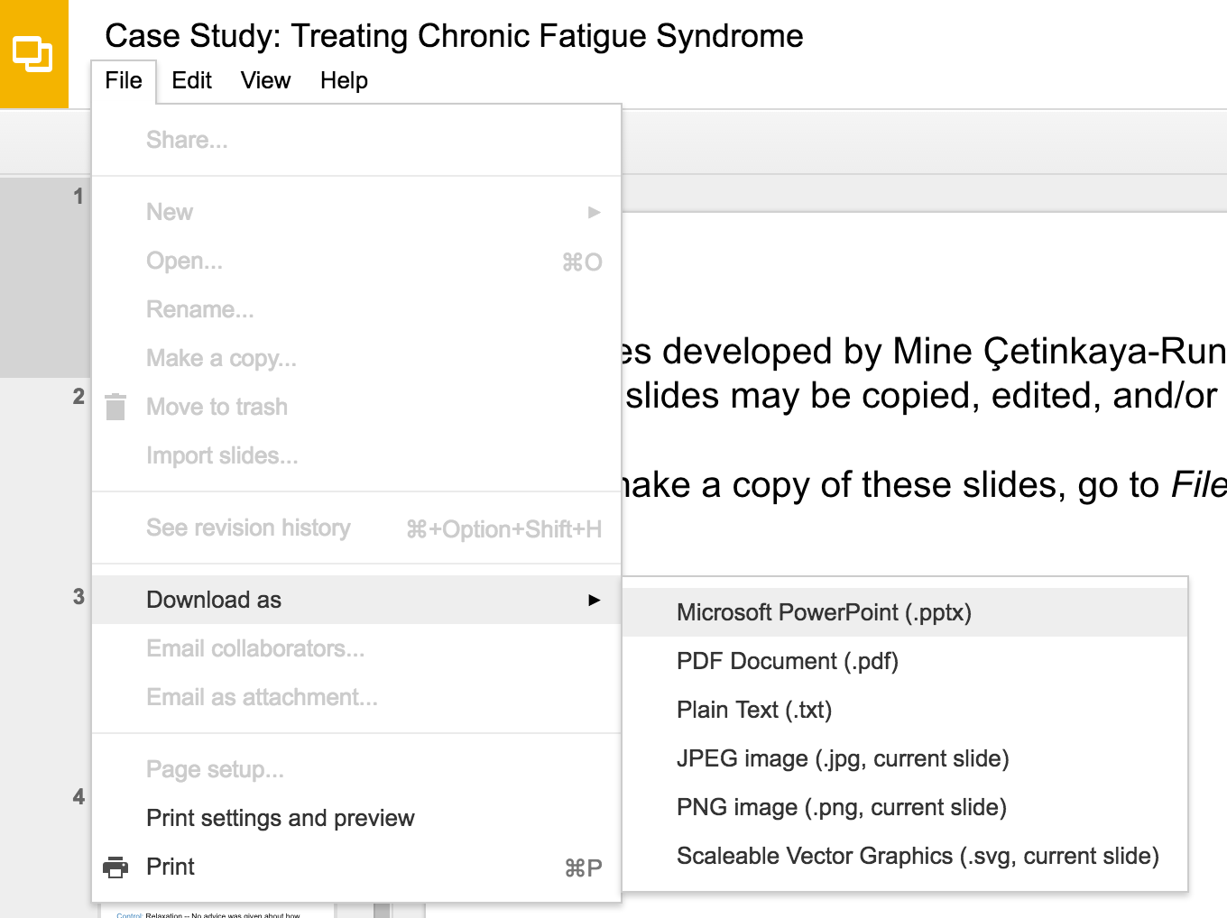
Slides developed by Mine Çetinkaya-Rundel of OpenIntro
Translated from LaTeX to Google Slides by Curry W. Hilton of OpenIntro.
The slides may be copied, edited, and/or shared via the CC BY-SA license
To make a copy of these slides, go to File > Download as > [option], as shown below. Or if you are logged into a Google account, you can choose Make a copy... to create your own version in Google Drive.

Slide 2
Confidence Intervals
for a Proportion

Slide 3


Confidence intervals
A plausible range of values for the population parameter is called a confidence interval.
Using only a sample statistic to estimate a parameter is like fishing in a murky lake with a spear, and using a confidence interval is like fishing with a net.
We can throw a spear where we saw a fish but we will probably miss. If we toss a net in that area, we have a good chance of catching the fish.
If we report a point estimate, we probably won't hit the exact population parameter. If we report a range of plausible values we have a good shot at capturing the parameter.
Photos by Mark Fischer (http://www.flickr.com/photos/fischerfotos/7439791462)
and Chris Penny (http://www.flickr.com/photos/clearlydived/7029109617) on Flickr.

Slide 4
Facebook’s categorization of user interests
Most commercial websites (e.g. social media platforms, news out- lets, online retailers) collect a data about their users’ behaviors and use these data to deliver targeted content, recommendations, and ads. To understand whether Americans think their lives line up with how the algorithm-driven classification systems categorizes them, Pew Research asked a representative sample of 850 American Facebook users how accurately they feel the list of categories Facebook has listed for them on the page of their supposed interests actually represents them and their interests. 67% of the respondents said that the listed categories were accurate. Estimate the true proportion of American Facebook users who think the Facebook categorizes their interests accurately.
https://www.pewinternet.org/2019/01/16/facebook-algorithms-and-personal-data/

Slide 5
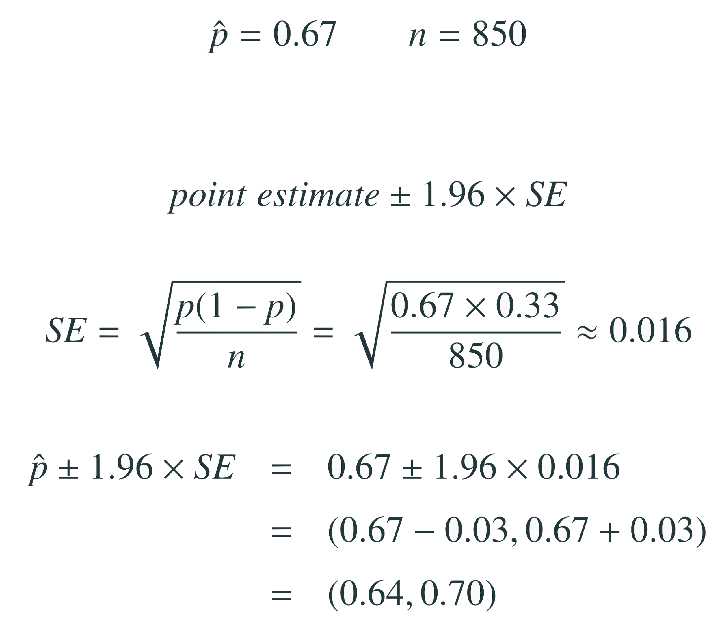
Facebook’s categorization of user interests
The approximate 95% confidence interval is defined as

Slide 6
Facebook’s categorization of user interests
Which of the following is the correct interpretation of this confidence interval? We are 95% confident that...
64% to 67% of American Facebook users in this sample think Facebook categorizes their interests accurately.
64% to 67% of all American Facebook users think Facebook categorizes their interests accurately
there is a 64% to 67% chance that a randomly chosen American Facebook user’s interests are categorized accurately.
there is a 64% to 67% chance that 95% of American Facebook users’ interests are categorized accurately.

Slide 7
Facebook’s categorization of user interests
Which of the following is the correct interpretation of this confidence interval? We are 95% confident that...
64% to 67% of American Facebook users in this sample think Facebook categorizes their interests accurately.
64% to 67% of all American Facebook users think Facebook categorizes their interests accurately
there is a 64% to 67% chance that a randomly chosen American Facebook user’s interests are categorized accurately.
there is a 64% to 67% chance that 95% of American Facebook users’ interests are categorized accurately.

Slide 8
What does 95% confident mean?
Suppose we took many samples and built a confidence interval from each sample using the equation
point estimate ± 1.96 × SE
Then about 95% of those intervals would contain the true population proportion (p).

Slide 9
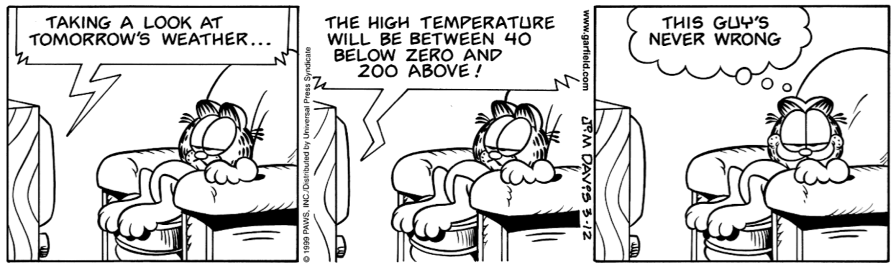
Width of an interval
If we want to be more certain that we capture the population parameter, i.e. increase our confidence level, should we use a wider interval or a smaller interval?
A wider interval.
Can you see any drawbacks to using a wider interval?
If the interval is too wide it may not be very informative.

Slide 10
Changing the confidence level
point estimate ± z★ × SE
In a confidence interval, z★ × SE is called the margin of error, and for a given sample, the margin of error changes as the confidence level changes.
In order to change the confidence level we need to adjust z★ in the above formula.
Commonly used confidence levels in practice are 90%, 95%, 98%, and 99%.
For a 95% confidence interval, z★ = 1.96.
However, using the standard normal (z) distribution, it is possible to find the appropriate z★ for any confidence level.

Slide 11
Which of the below Z scores is the appropriate z⋆ when calculating a 98% confidence interval?
(a) Z = 2.05 (d) Z = −2.33
(b) Z = 1.96 (e) Z = −1.65
(c) Z = 2.33

Slide 12
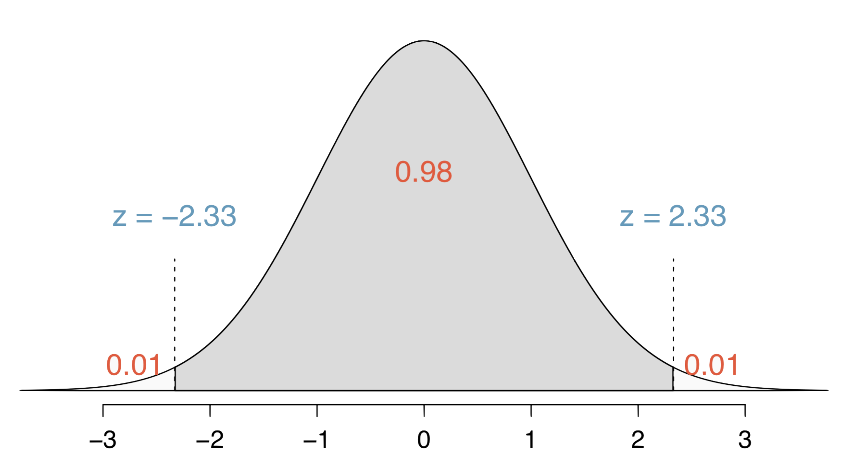
Which of the below Z scores is the appropriate z⋆ when calculating a 98% confidence interval?
(a) Z = 2.05 (d) Z = −2.33
(b) Z = 1.96 (e) Z = −1.65
(c) Z = 2.33

Slide 13
Interpreting confidence intervals
Confidence intervals are ...
always about the population
are not probability statements
only about population parameters, not individual observations
only reliable if the sample statistic they’re based on is an unbiased estimator of the population parameter

Slide 14
Find more resources at openintro.org/os, including
Slides
Videos
Statistical Software Labs
Discussion Forums (free support for students and teachers)
Learning Objectives
Teachers only content is also available for Verified Teachers, including
Exercise solutions
Sample exams
Ability to request a free desk copy for a course
Statistics Teachers email group
Questions? Contact us.

Slide 15
Extra Slides from the OS3 section on confidence intervals

Slide 16
Average number of exclusive relationships
A random sample of 50 college students were asked how many exclusive relationships they have been in so far. This sample yielded a mean of 3.2 and a standard deviation of 1.74. Estimate the true average number of exclusive relationships using this sample.

Slide 17
Average number of exclusive relationships
A random sample of 50 college students were asked how many exclusive relationships they have been in so far. This sample yielded a mean of 3.2 and a standard deviation of 1.74. Estimate the true average number of exclusive relationships using this sample.
x̄ = 3.2 s = 1.74

Slide 18
Average number of exclusive relationships
A random sample of 50 college students were asked how many exclusive relationships they have been in so far. This sample yielded a mean of 3.2 and a standard deviation of 1.74. Estimate the true average number of exclusive relationships using this sample.
x̄ = 3.2 s = 1.74
The approximate 95% confidence interval is defined as
point estimate ± 2 x SE

Slide 19
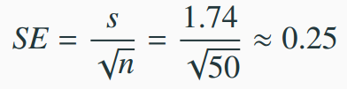
Average number of exclusive relationships
A random sample of 50 college students were asked how many exclusive relationships they have been in so far. This sample yielded a mean of 3.2 and a standard deviation of 1.74. Estimate the true average number of exclusive relationships using this sample.
x̄ = 3.2 s = 1.74
The approximate 95% confidence interval is defined as
point estimate ± 2 x SE

Slide 20
Average number of exclusive relationships
A random sample of 50 college students were asked how many exclusive relationships they have been in so far. This sample yielded a mean of 3.2 and a standard deviation of 1.74. Estimate the true average number of exclusive relationships using this sample.
x̄ = 3.2 s = 1.74
The approximate 95% confidence interval is defined as
point estimate ± 2 x SE
x̄ ± 2 x SE → 3.2 ± 2 x 0.25
→ (3.2 - 0.5, 3.2 + 0.5)
→ (2.7, 3.7)

Slide 21
Practice
Which of the following is the correct interpretation of this confidence interval?
We are 95% confident that
(a) the average number of exclusive relationships college students in this sample have been in is between 2.7 and 3.7.
(b) college students on average have been in between 2.7 and 3.7 exclusive relationships.
(c) a randomly chosen college student has been in 2.7 to 3.7 exclusive relationships.
(d) 95% of college students have been in 2.7 to 3.7 exclusive relationships.

Slide 22
Practice
Which of the following is the correct interpretation of this confidence interval?
We are 95% confident that
(a) the average number of exclusive relationships college students in this sample have been in is between 2.7 and 3.7.
(b) college students on average have been in between 2.7 and 3.7 exclusive relationships.
(c) a randomly chosen college student has been in 2.7 to 3.7 exclusive relationships.
(d) 95% of college students have been in 2.7 to 3.7 exclusive relationships.

Slide 23
A more accurate interval
Confidence interval, a general formula
point estimate ± z* x SE

Slide 24
A more accurate interval
Confidence interval, a general formula
point estimate ± z* x SE
Conditions when the point estimate = x̄
Independence: Observations in the sample must be independent
random sample/assignment
if sampling without replacement, n < 10% of population
Sample size / skew: n ≥ 30 and population distribution should not be extremely skewed

Slide 25
A more accurate interval
Confidence interval, a general formula
point estimate ± z* x SE
Conditions when the point estimate = x̄
Independence: Observations in the sample must be independent
random sample/assignment
if sampling without replacement, n < 10% of population
Sample size / skew: n ≥ 30 and population distribution should not be extremely skewed
Note: We will discuss working with samples where n < 30 in the next chapter.

Slide 26
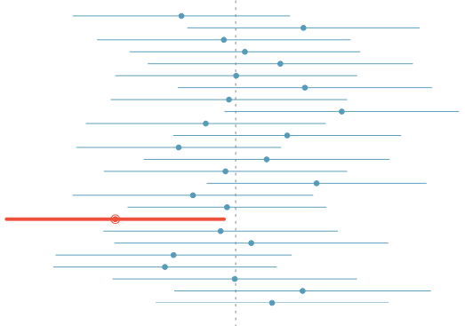
What does 95% confident mean?
Suppose we took many samples and built a confidence interval from each sample using the equation point estimate ± 2 x SE.
Then about 95% of those intervals would contain the true population mean (µ).
The figure shows this process with 25 samples, where 24 of the resulting confidence intervals contain the true average number of exclusive relationships, and one does not.

Slide 27
Width of an interval
If we want to be more certain that we capture the population parameter, i.e. increase our confidence level, should we use a wider interval or a smaller interval?

Slide 28
Width of an interval
If we want to be more certain that we capture the population parameter, i.e. increase our confidence level, should we use a wider interval or a smaller interval?
A wider interval.

Slide 29
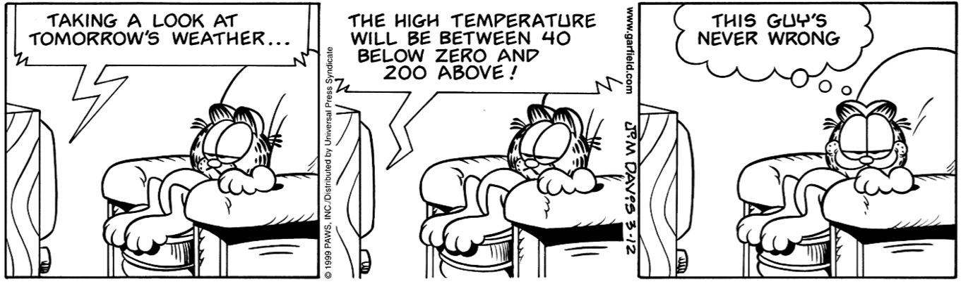
Width of an interval
If we want to be more certain that we capture the population parameter, i.e. increase our confidence level, should we use a wider interval or a smaller interval?
A wider interval.
Can you see any drawbacks to using a wider interval?
Image source: http://web.as.uky.edu/statistics/users/earo227/misc/garfield_weather.gif

Slide 30
Width of an interval
If we want to be more certain that we capture the population parameter, i.e. increase our confidence level, should we use a wider interval or a smaller interval?
A wider interval.
Can you see any drawbacks to using a wider interval?
If the interval is too wide it may not be very informative.
Image source: http://web.as.uky.edu/statistics/users/earo227/misc/garfield_weather.gif

Slide 31
Changing the confidence level
point estimate ± z* x SE
In a confidence interval, z* x SE is called the margin of error, and for a given sample, the margin of error changes as the confidence level changes.
In order to change the confidence level we need to adjust z* in the above formula.
Commonly used confidence levels in practice are 90%, 95%, 98%, and 99%.
For a 95% confidence interval, z* = 1.96.
However, using the standard normal (z) distribution, it is possible to find the appropriate z* for any confidence level.

Slide 32
Practice
Which of the below Z scores is the appropriate z* when calculating a 98% confidence interval?
(a) Z = 2.05
(b) Z = 1.96
(c) Z = 2.33
(d) Z = -2.33
(e) Z = -1.65

Slide 33
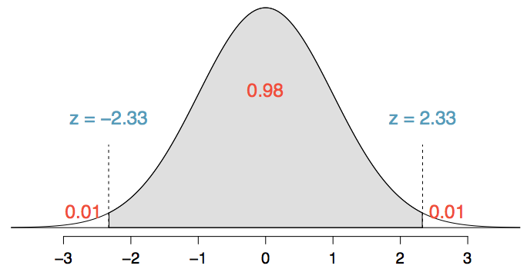
Practice
Which of the below Z scores is the appropriate z* when calculating a 98% confidence interval?
(a) Z = 2.05
(b) Z = 1.96
(c) Z = 2.33
(d) Z = -2.33
(e) Z = -1.65

